Slide 1
Android
Android Developer Fundamentals
Lesson 1
This work is licensed under a Creative Commons Attribution-NonCommercial 4.0 International License

Slide 2
All About Lecture
This work is licensed under a Creative Commons Attribution-NonCommercial 4.0 International License

Slide 3
Course Description
Mata Kuliah | : | Pemrograman Perangkat Bergerak
Kode | : | 334161-5326
Jumlah SKS | : | 2 Sks Teori, 1 Sks Praktikum
Deskripsi | : | Setelah mengikuti perkuliahan selama satu semester, mahasiswa diharapkan dapat merancang dan membuat aplikasi perangkat bergerak menggunakan android. Mampu membuat antarmuka pengguna yang responsif serta adaptif untuk berbagai perangkat, serta mampu membuat dan menguji aplikasi.

Slide 4
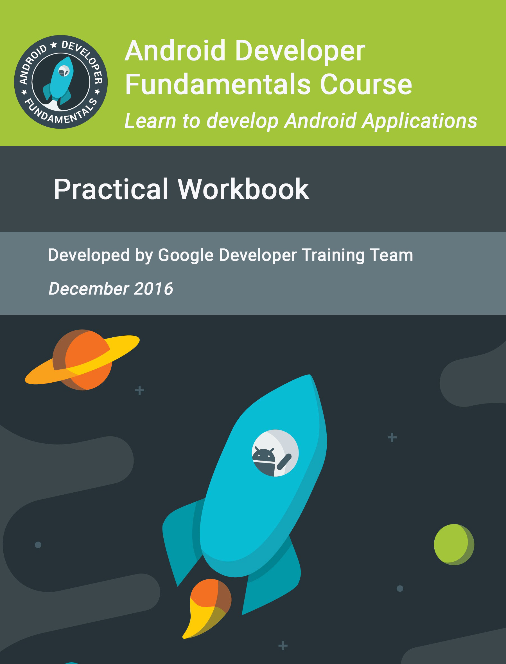
Reference
Google Developer Training Team, “Android Developer Fundamental Course : Learn to Develop Android Application”, Google Developer.
Guntoro, “Android Studio Mastery : Panduan Membuat Aplikasi Android untuk Pemula dalam 9 hari”, Badoy Studio.
Dicoding Team, “ Belajar Membuat Aplikasi Android Pemula”, Dicoding.
Dokumentasi android online pada https://developers.google.com/

Slide 5
Lecture Techniques
Metode Pembelajaran Tatap muka (2 x 45) menit, presentasi materi, diskusi, tugas.
Durasi Perkuliahan ± 18 minggu
Jadwal sesuai dengan yang sudah ditentukan prodi
Pergeseran / Pengosongan Mata Kuliah diumumkan melalui akademik & koordinator mata kuliah
Maksimal keterlambatan ± 5 menit, Sanksi keterlambatan adalah tidak boleh absen
Kehadiran minimal 75% (akademik) → sakit & izin harus ada suratnya, tidak menerima izin lewat wa.

Slide 6
Assessment
Unsur Penilaian | Bobot (%)
Kehadiran | 15%
Kuis | 10%
Tugas | 20%
UTS | 25%
UAS | 30
Rentang Nilai | Nilai
> 80 | A
75 – 79 | AB
70 – 74 | B
66 – 69 | BC
60 – 65 | C
40 – 59 | D
0 - 39 | E

Slide 7
1.0 Introduction to Android
This work is licensed under a Creative Commons Attribution-NonCommercial 4.0 International License

Slide 8

Contents
Android is an ecosystem
Android platform architecture
Android Versions
Challenges of Android app development
App fundamentals

Slide 9
Android Ecosystem
This work is licensed under a Creative Commons Attribution-NonCommercial 4.0 International License

Slide 10
What is Android?
Mobile operating system based on Linux kernel
User Interface for touch screens
Used on over 80% of all smartphones
Powers devices such as watches, TVs, and cars
Over 2 Million Android apps in Google Play store
Highly customizable for devices / by vendors
Open source

Slide 11
Android user interaction
Touch gestures: swiping, tapping, pinching
Virtual keyboard for characters, numbers, and emoji
Support for Bluetooth, USB controllers and peripherals

Slide 12
Android and sensors
Sensors can discover user action and respond
Device contents rotate as needed
Walking adjusts position on map
Tilting steers a virtual car or controls a physical toy
Moving too fast disables game interactions

Slide 13
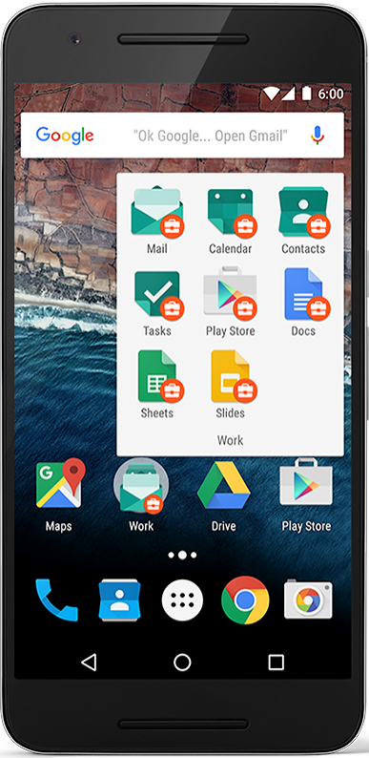
Android home screen
Launcher icons for apps
Self-updating widgets for live content
Can be multiple pages
Folders to organize apps
"OK Google"

Slide 14
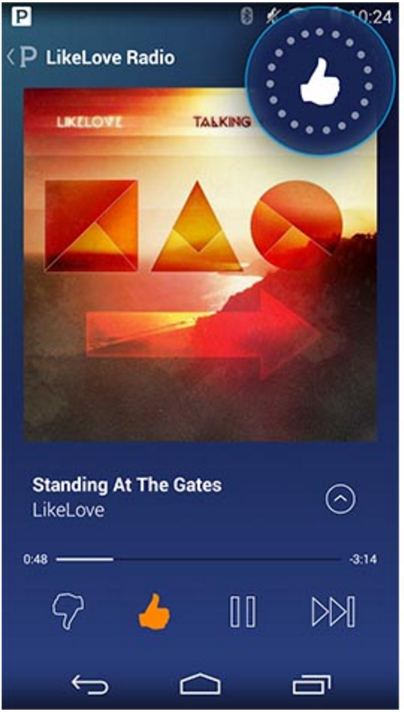
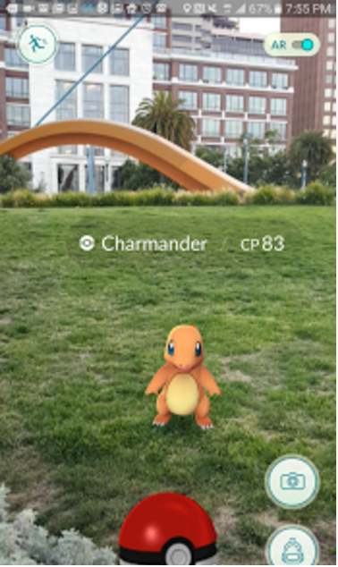
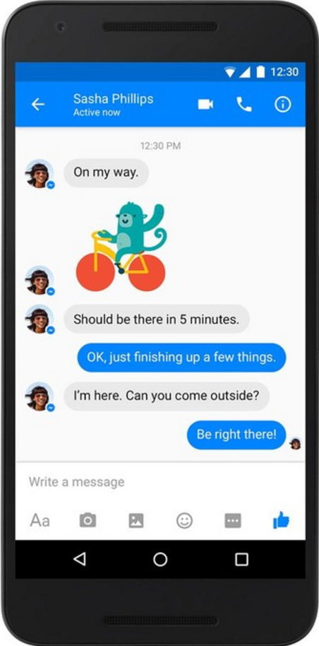
Android app examples
Pandora
Pokemon GO
Facebook Messenger

Slide 15
Android Software Developer Kit (SDK)
Development tools (debugger, monitors, editors)
Libraries (maps, wearables)
Virtual devices (emulators)
Documentation (developers.android.com)
Sample code

Slide 16
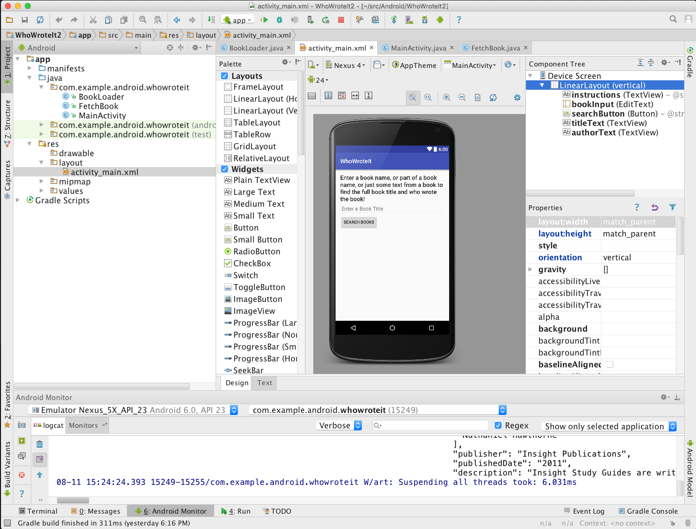
Android Studio
Official Android IDE
Develop, run, debug, test, and package apps
Monitors and performance tools
Virtual devices
Project views
Visual layout editor

Slide 17

Google Play store
Publish apps through Google Play store:
Official app store for Android
Digital distribution service operated by Google

Slide 18
Android Platform Architecture
This work is licensed under a Creative Commons Attribution-NonCommercial 4.0 International License

Slide 19
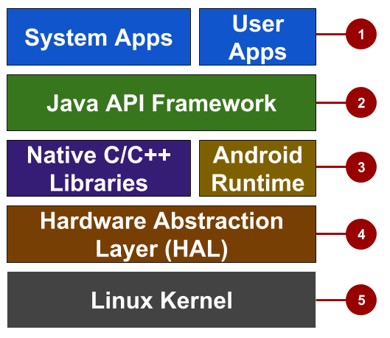
Android stack
System and user apps
Android OS API in Java framework
Expose native APIs; run apps
Expose device hardware capabilities
Linux Kernel

Slide 20
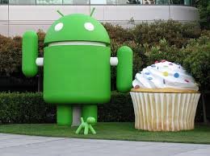
System and user apps
System apps have no special status
System apps provide key capabilities to app developers
Example:
Your app can use a system app to deliver a SMS message.

Slide 21
Java API Framework
The entire feature-set of the Android OS is available to you through APIs written in the Java language.
View class hierarchy to create UI screens
Notification manager
Activity manager for life cycles and navigation
Content providers to access data from other apps

Slide 22
Android runtime
Each app runs in its own process with its own instance of the Android Runtime.

Slide 23
C/C++ libraries
Core C/C++ Libraries give access to core native Android system components and services.

Slide 24
Hardware Abstraction Layer (HAL)
Standard interfaces that expose device hardware capabilities as libraries Examples: Camera, bluetooth module

Slide 25
Linux Kernel
Threading and low-level memory management
Security features
Drivers

Slide 26

Android versions
Codename | Version | Released | API Level
Jelly Bean | 4.1 - 4.3.1 | July 2012 | 16 - 18
KitKat | 4.4 - 4.4.4 | Oct 2013 | 19 - 20
Lollipop | 5.0 - 5.1.1 | Nov 2014 | 21 - 22
Marshmallow | 6.0 - 6.0.1 | Oct 2015 | 23
Nougat | 7.0 | Sept 2016 | 24
Orea | 8.0 | Okt 2017 | 26 - 27
Pie | 9.0 | Ags 2018 | 28
Android History and Platform Versions
for more and earlier versions before 2011
Notes:
There were earlier versions before Feb 2011.

Slide 27
App Development
This work is licensed under a Creative Commons Attribution-NonCommercial 4.0 International License

Slide 28
What is an Android app?
One or more interactive screens
Written using Java Programming Language and XML
Uses the Android Software Development Kit (SDK)
Uses Android libraries and Android Application Framework
Executed by Android Runtime Virtual machine (ART)

Slide 29
Challenges of Android development
Multiple screen sizes and resolutions
Performance: make your apps responsive and smooth
Security: keep source code and user data safe
Compatibility: run well on older platform versions
Marketing: understand the market and your users (Hint: It doesn't have to be expensive, but it can be.)

Slide 30
App building blocks
Resources: layouts, images, strings, colors as XML and media files
Components: activities, services, …, and helper classes as Java code
Manifest: information about app for the runtime
Build configuration: APK versions in Gradle config files

Slide 31
Component types
Activity is a single screen with a user interface
Service performs long-running tasks in background
Content provider manages shared set of data
Broadcast receiver responds to system-wide announcements

Slide 32
Think of Android as a hotel
Your app is the guest
The Android System is the hotel manager
Services are available when you request them (intents)
In the foreground (activities) such as registration
In the background (services) such as laundry
Calls you when a package has arrived (broadcast receiver)
Access the city's tour companies (content provider)

Slide 33
Learn more
Android History
Introduction to Android
Platform Architecture
UI Overview
Platform Versions
Supporting Different Platform Versions
Android Studio User’s Guide

Slide 34
What's Next?
Concept Chapter: 1.0 C Introduction to Android
Practical: –

Slide 35
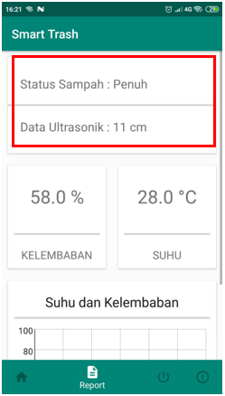
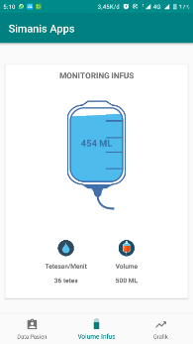
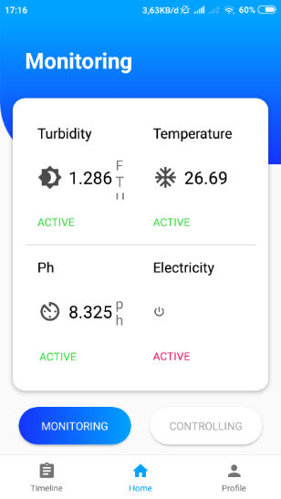
Implementation

Slide 36
END

